Slide 1




Dr.Ranjit K.N
Hod CSE Dept
MAHARAJA INSTITUTE OF TECHNOLOGY THANDAVAPURA
DEPARTMENT OF COMPUTER SCIENCE AND ENGINEERING
MAJOR PROJECT
BLOCK CHAIN BASED NATIONAL
DIGITAL COIN(NDC)
Ganesh A Kashyap 4MN21CS018
Pavan M V 4MN21CS033
UNDER THE GUIDANCE OF:
Shashank v Kashyap 4MN21CS045
Prof. Madhu B
PROFESSOR
DEPT OF CSE
Dhananjaya G 4MN22CS400

Slide 2



INTRODUCTION
Blockchain-Powered & State-Backed Digital Currency
NDCs provide a secure, transparent, and efficient alternative to physical cash.
Unlike cryptocurrencies, they are government-regulated while benefiting from decentralization.
Next-Generation Financial Infrastructure
Utilizes blockchain, smart contracts, and DeFi for scalability and security.
Ensures instant transactions, reduced fraud, and enhanced financial inclusion.
Regulatory Oversight with Technological Innovation
Maintains government control while enabling tamper-proof transactions.
Adheres to compliance regulations while improving accessibility and efficiency.
Future-Proof Digital Economy
Integrates cryptographic security, cross-border compatibility, and automation.
Provides a fast, accessible, and scalable alternative to traditional fiat currencies.

Slide 3
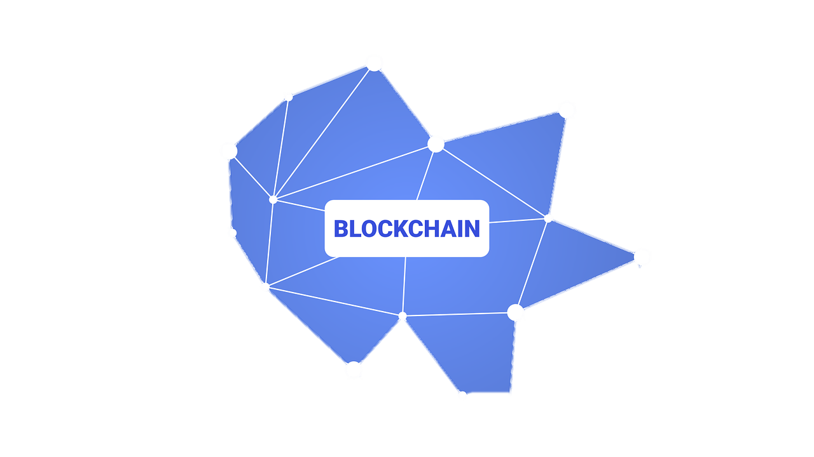

Problem Statement
Financial Mismanagement & Corruption – Lack of transparency in fund allocation leads to inefficiencies, corruption, and resource loss.
Absence of Secure Tracking – Traditional systems rely on centralized control, making transactions vulnerable to tampering and unauthorized modifications.
Government Project Challenges – Large funds for public services often face discrepancies, delays, and misallocations due to lack of real-time visibility.
Blockchain-Based Solution – A National Digital Currency (NDC) using blockchain and Web3 ensures secure, transparent, and immutable transactions.
Smart Contract Fund Tracking – Automates real-time monitoring, eliminating middlemen, enhancing accountability, and streamlining auditing.

Slide 4



Existing System Drawbacks
Lack of Transparency – Centralized financial systems make it difficult to track fund flow, leading to corruption and mismanagement.
Manual & Inefficient Auditing – Traditional financial systems rely on manual processes, making auditing slow and prone to errors or manipulation.
High Intermediary Involvement – Multiple intermediaries in transactions increase costs, delays, and opportunities for fund diversion.
Security Vulnerabilities – Centralized databases are susceptible to cyberattacks, fraud, and unauthorized modifications.
Delayed Transactions – Government and financial processes often involve bureaucratic delays, affecting real-time fund utilization.
Lack of Real-Time Tracking – No real-time visibility into fund distribution results in inefficiencies and misallocation.

Slide 5

Proposed System Advantages & Overcoming Drawbacks
1 Decentralization & Elimination of Intermediaries: Drawback Overcome: Traditional banking systems rely on centralized institutions that can be slow, expensive, and prone to failure. Solution:
Blockchain removes the need for central authorities, making transactions peer-to-peer (P2P).
Eliminates bank failures, excessive fees, and processing delays.
2 Enhanced Security & Fraud Prevention: Drawback Overcome: Traditional digital payment systems are vulnerable to hacking, identity theft, and double spending. Solution:
Uses cryptographic encryption & consensus mechanisms (PoW/PoS) to prevent fraud.
Transactions are immutable, meaning they cannot be altered or deleted.

Slide 6
Proposed System Advantages & Overcoming Drawbacks
3 Transparency & Traceability: Drawback Overcome: Cash transactions allow money laundering, corruption, and tax evasion due to a lack of transparency. Solution:
Every transaction is recorded on the blockchain, making it publicly verifiable.
Ensures end-to-end transparency while maintaining user privacy.
4 Improved Monetary Policy Control: Drawback Overcome: Traditional cash-based economies make it hard for central banks to track and control money supply. Solution:
Blockchain-based NDC allows real-time monitoring of circulation.
Authorities can control inflation, prevent black money circulation, and stabilize the economy.

Slide 7
SOFTWARE DEVELOPMENT GUIDE
Security & Encryption
Use AES-256 encryption for data storage and TLS 1.3 for secure communication.
Implement multi-signature wallets to prevent unauthorized transactions.
Ensure smart contract security by auditing for vulnerabilities like reentrancy attacks.
Scalability & Performance
Optimize block validation time to ensure fast transactions.
Use Layer-2 scaling solutions (like Rollups) to reduce congestion.
Implement efficient consensus mechanisms (e.g., Proof-of-Stake for better efficiency).
Data Integrity & Transparency
Store transaction history in a tamper-proof blockchain ledger.
Implement zero-knowledge proofs (ZKPs) for privacy without compromising transparency.
Use hashing (SHA-256) to ensure data immutability.

Slide 8
SOFTWARE DEVELOPMENT GUIDE
Compliance & Legal Considerations
Follow GDPR and data protection laws for user privacy.
Ensure interoperability with existing financial systems (e.g., SWIFT, UPI, etc.).
Fault Tolerance & Recovery
Implement automatic rollback mechanisms for failed transactions.
Maintain a redundant node system to ensure uptime.
Regularly update backup strategies to prevent data loss.

Slide 9

QUESTIONS
THANKYOU

